Slide 1




Food Waste
This is Compo – Wheelie’s food bin friend. He would like to tell you all about food waste.
Notes:
Welcome to the Wheelie Big Challenge from Eco-Schools supported by Belfast City Council. This is Compo – Wheelie’s brown food bin friend. He would like to tell you all about food waste.

Slide 2
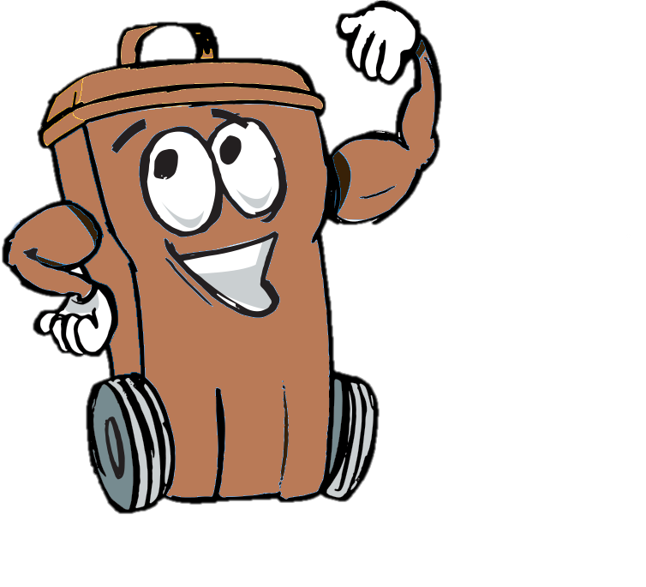
Wheelie’s Lessons
learn and think
Wheelie Big Actions
research and act
Wheelie Big Competition
report, display and win!
Notes:
The Wheelie Big Challenge is in 3 parts. In 2016 we are asking schools to look at food waste as well as other recycling.

Slide 3
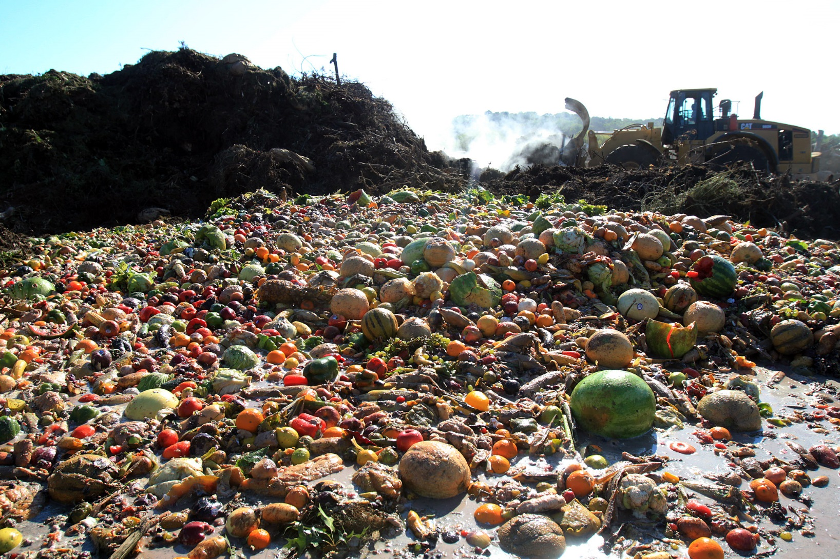
How much food do we waste?
Worldwide we throw away 2 billion tonnes of food a year.
In UK households we waste around
7 million tonnes of food a year
Over 1/3 of the world’s food production never reaches a plate
Which costs us £17 billion a year
Notes:
What is waste? – for this challenge we are talking about our rubbish that goes to landfill and is not recycled. We throw away a shocking amount of food each year.

Slide 4
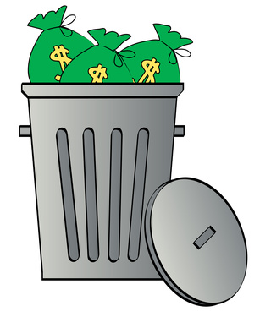

That’s a lot of waste!!
Why should we care?
Because it costs money
and it’s bad for the environment.
Notes:
Disposing of waste costs the tax payer and your council a lot of money. That money could be spent on better things like parks and leisure facilities. Landfill sites are also very bad for the environment, as well as being unsightly, they cause litter and air pollution, harm wildlife and contribute to global warming.

Slide 5

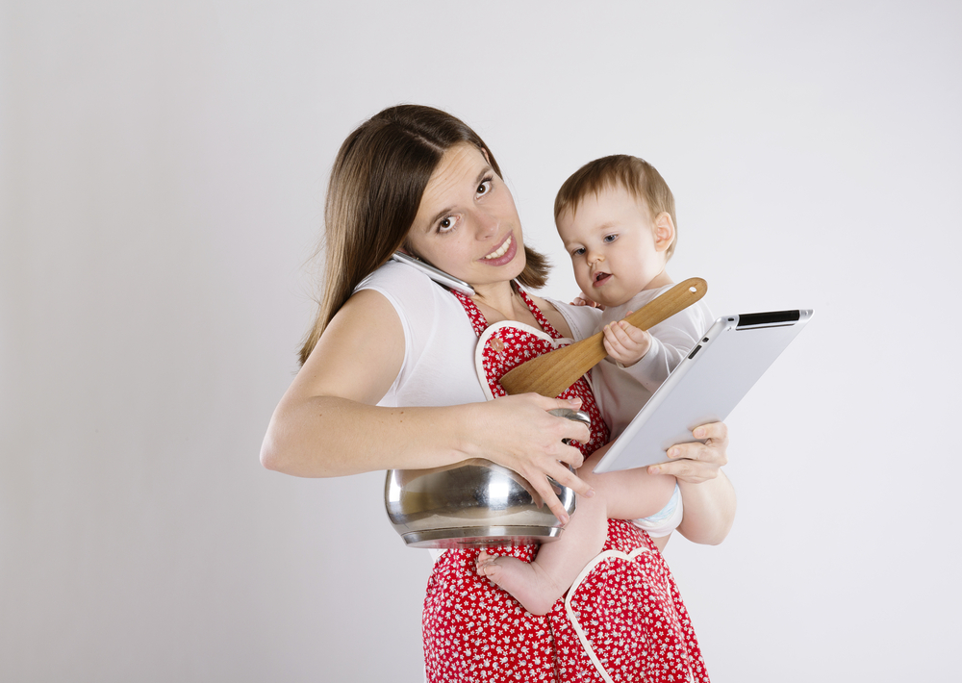
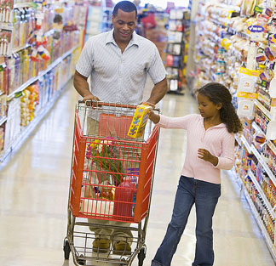
Where does your food come from?
It doesn’t appear by magic
It takes a lot of energy to make it – and not just from your Mum!
If you said ‘supermarket’ that’s only part of the story.
Notes:
Ask pupils where they think their food comes from. You could visit your local shop and look for the product which has travelled the furthest.

Slide 6
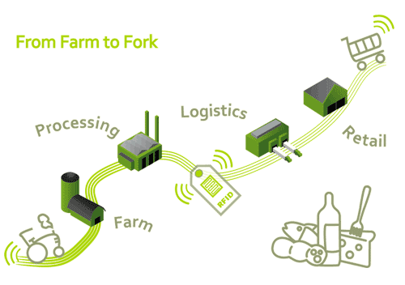
A lot of your food will probably have travelled a long way before it arrives on your plate
Water
Storage
Energy
Transport
Storage
Fuel
Energy
Transport
Energy
Fuel
Transport
Transport
Energy
Water
Storage
Fuel
Notes:
Food miles add to the problem of environmental impact. Our demand for certain foods all year round means our food can have travelled from half way round the world. Ask pupils to consider the environmental impact of food production at different stages from food to fork. Where possible it is always better to buy local produce.

Slide 7
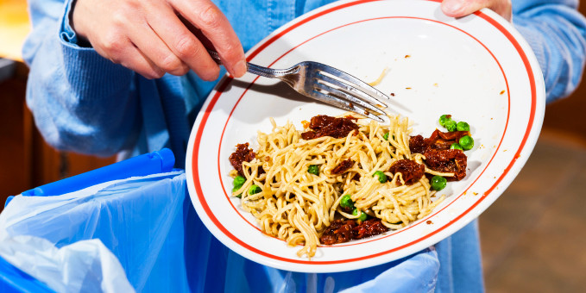
If you throw that food in the bin you are:
Wasting all the energy that got that food from farm to fork
Wasting money
Adding to the mountain of wasted food in landfill
Adding to climate change
Notes:
It is not just the food that is wasted when it goes in the bin but also all the energy, transport and storage costs and environmental impact at each stage of the journey that is wasted.

Slide 8
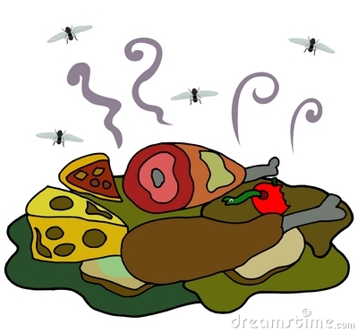
Food waste stinks!
That pongy smell is bacteria creating methane gas a potent contributor to climate change
The carbon footprint of food produced and not eaten is estimated at 3.3 billion tons of greenhouse gases: making food wastage the third top GHG emitter after the U.S. and China
Notes:
Methane is more dangerous and more damaging than CO2. Wasted food globally causes greenhouse gases equivalent to a large industrialised country and comes only third to the USA and China in terms of greenhouse gases emitted. The food we throw away is causing a greater environmental hazard than the packaging it comes in – yet most people, 88%, think packaging is a bigger or equal problem.

Slide 9
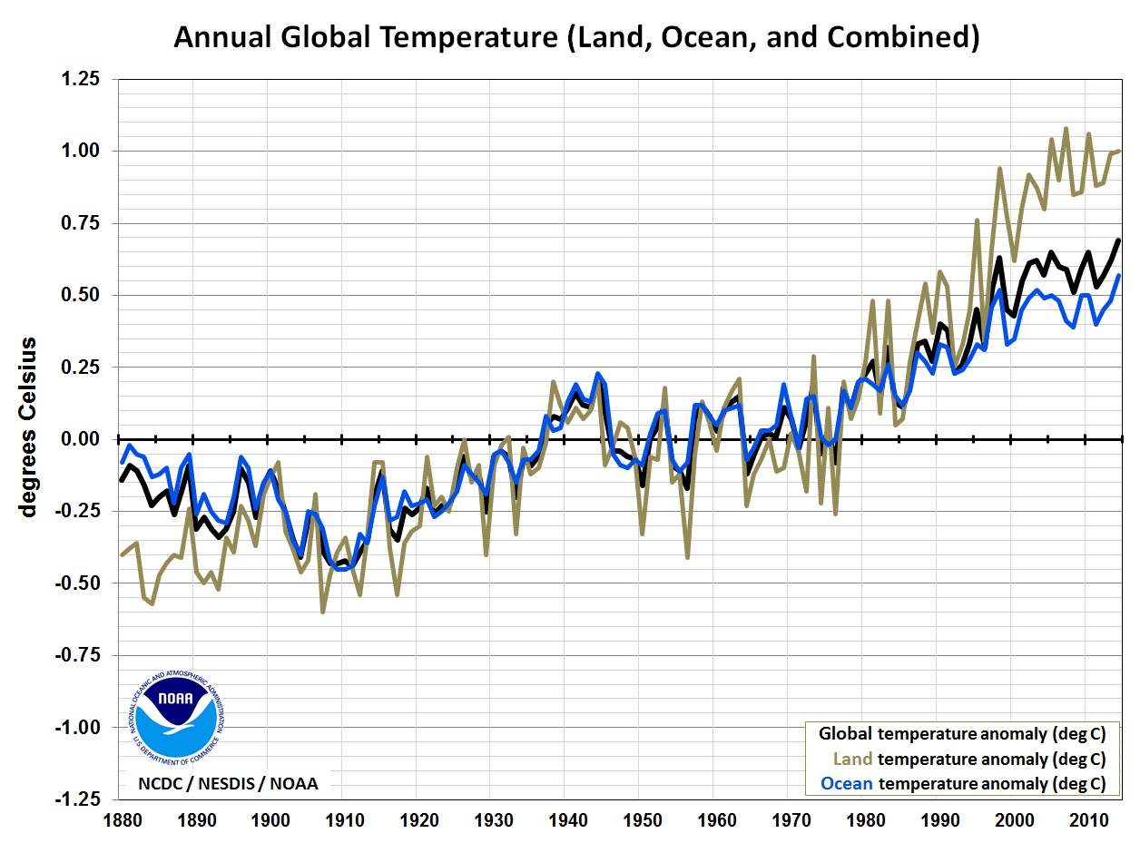
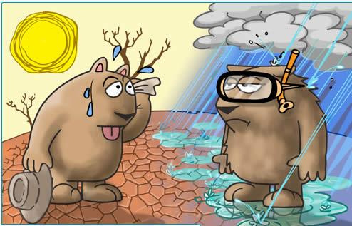
Greenhouse gases from industry and waste in our atmosphere trap the heat from the sun
Our planet is heating up a little every year
Global warming is affecting our climate and as a result we are experiencing more extreme weather events.
Notes:
The graph shows global temperatures rising in degrees. This rises steadily form 1880 when industrialisation began. Climate change does not necessarily mean warmer weather. Some countries where it is already warm will experience more droughts and here in Northern Ireland we are likely to experience wetter weather.

Slide 10
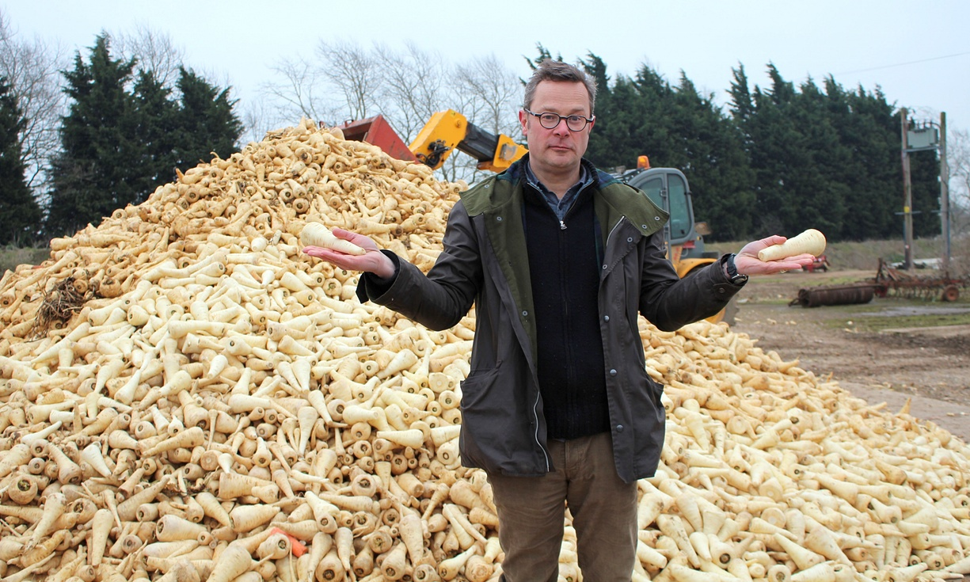
The wonky vegetable scandal
TV chef Hugh Fearnley-Whittingstall reported in a BBC programme ‘Hugh’s War on Waste’, that up to 40% of a farmers crop can be thrown away because it’s not quite the right shape or size to meet supermarket standards.
One farmer had to throw away 20 tonnes of vegetables a week!
It’s a bit crazy!
Notes:
Visit www.wastenotuk.com for more information on this anti-waste campaign and hints and tips.

Slide 11
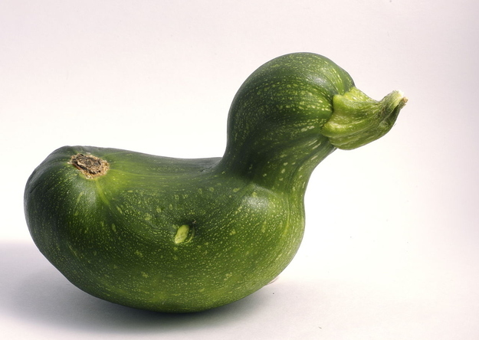
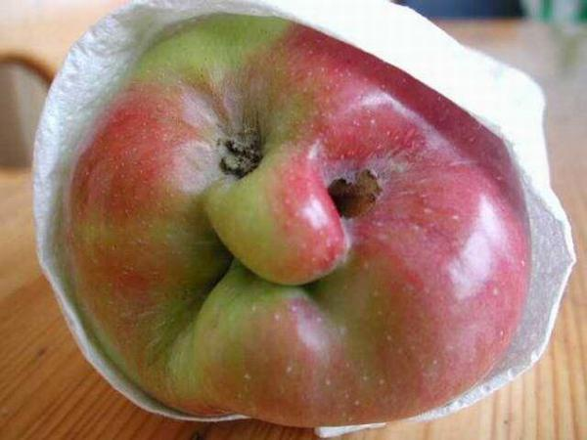
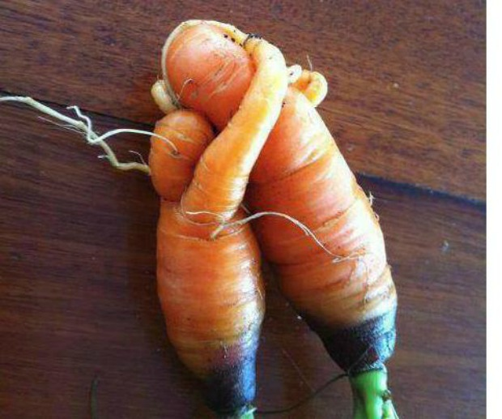
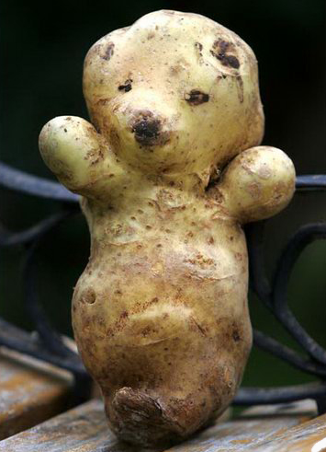
Even ugly veg need love !
And taste great!
Notes:
Food still tastes great no matter what the shape. Supermarket standards of appearance are not natural and creating a lot of wasted food.

Slide 12


Supermarkets aren’t the only ones wasting food.
£700 per family
£12.5 million
7 million tonnes
HOME
Notes:
Figures from Love Food Hate Waste based on the UK. 7 million tonnes of food costing the consumer £12.5 million is thrown away from UK households every year costing the a family household an average £700 a year. Visit www.ni.lovefoodhatewaste.com for more facts and figures.

Slide 13

What can we do?
Which is best?
Notes:
The 3 R’s are important if we are to become a sustainable society – but which is best?

Slide 14

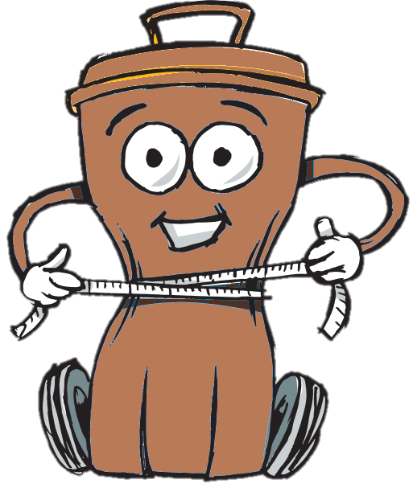
is the best option
Reduce waste
  buy only what you need
  manage portion sizes
  check sell by dates
  use a shopping list
  store food properly
Save the environment
Save money
Notes:
Reduce is always the best option because it will use less natural resources and less energy in the first place. We can try and reduce food waste by managing portion sizes, planning our food shopping for the week and making sure we understand sell by dates on packaging properly. Go to www.nilovefoodhatewasteni.com for more hints and tips.

Slide 15
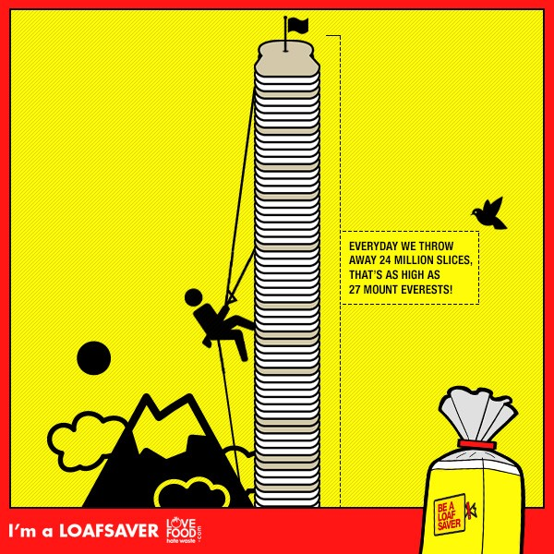
Every day we throw away 24 million slices of bread in the UK
Stacked up that’s as high as 27 Mount Everest’s!
Did you know you can toast your sliced bread straight from the freezer? So don’t waste it, freeze it!
Notes:
Bread stays freshest if it stored in a dark dry place - like a breadbin or cupboard. But if you think a whole loaf is too much to get through why not freeze half and use it as you need it?

Slide 16


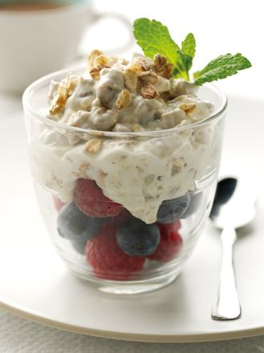

Use yummy left overs for a tasty meal or save some of last night’s dinner for lunch today.
Visit https://www.lovefoodhatewaste.com/recipes for lots of great ideas.
Make friends with your freezer.
Hi
Notes:
Reusing is important too – can the pupils think of ways they could reuse food at home – what meals can they think of? Visit www.ni.lovefoodhatewasteni.com for tasty ideas. If you make too much of something freeze it and save it for another day.

Slide 17

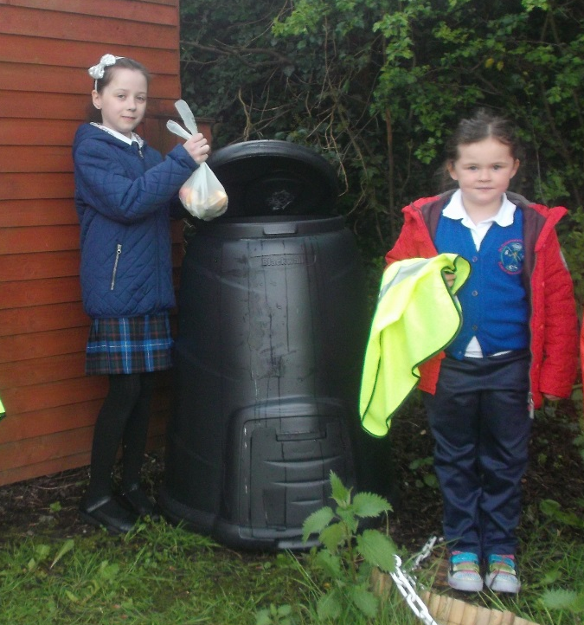
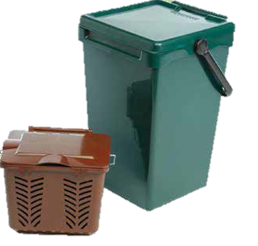
If you have food scraps that have to be thrown away then check if they can be recycled in the compost or brown bin.
Belfast City Council’s Waste education team can visit your school to talk about composting contact wasteeducation@belfastcity.gov.uk
Notes:
Can the pupils think of any other products they have commonly seen made from recycled materials.

Slide 18
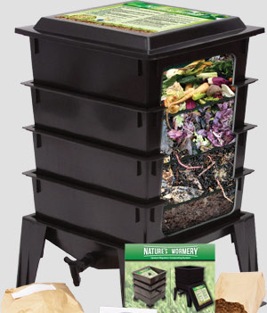

You could use a wormery to make compost.
Wormeries are great for composting small amounts of food waste
They make really good compost and plant food
You have to take care of your worms and look after them!
Notes:
Wormeries are a great way to compost small amounts of food. You add food scraps into the top tray and the worms will keep working their way up looking for new food. They leave behind a lovely layer of compost in the bottom tray which you can empty out and rotate to the top. There is a tap in the bottom to drain off liquid which makes fabulous plant feed. Contact Eco-Schools for more information.

Slide 19
What happens to food waste after the Council collect it?
It is mixed with garden waste –shredded and then composted in an enclosed system for around 2-4 weeks (temperatures of up to 70°C speed up the process and ensure any harmful microbes are killed off).
The material is then left outside to mature for a further 1-3 months with regular turning and checks to ensure quality before going on to be used as soil conditioner.
Sometimes your council recycling amenity centre will offer free bags of this compost for you to use at home or school.
Notes:
Brown bin and food waste in Belfast is turned into compost. In some other parts of the UK it used to create energy form the Biogases produced.

Slide 20
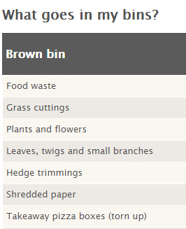
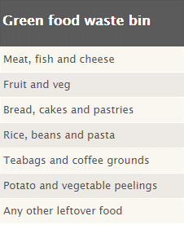

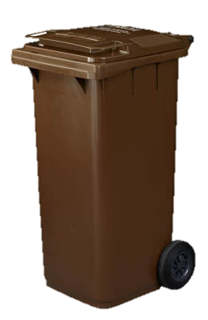
Notes:
This information is from the Belfast City Council website where there is lots of helpful advice on recycling at home.

Slide 21


Black bin landfill waste costs nearly twice as much than recycling food to compost
Black Bin Waste goes to Landfill
Each bin lorry costs £1000 pounds to dispose of.
Food Bin Waste goes to compost
Each bin lorry costs £520 pounds to compost.
Notes:
Landfill taxes are increasing all the time which means that disposing of waste this way is expensive. Landfill taxes will cause the cost of a lorry of waste to landfill to increase to £1000 in April 2015. Recycling is a much better option for the environment and our purse strings as it provides a valuable resource for manufacturers and is cheaper than producing new products from raw materials.

Slide 22
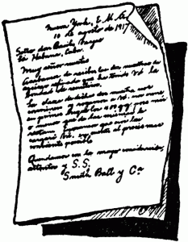
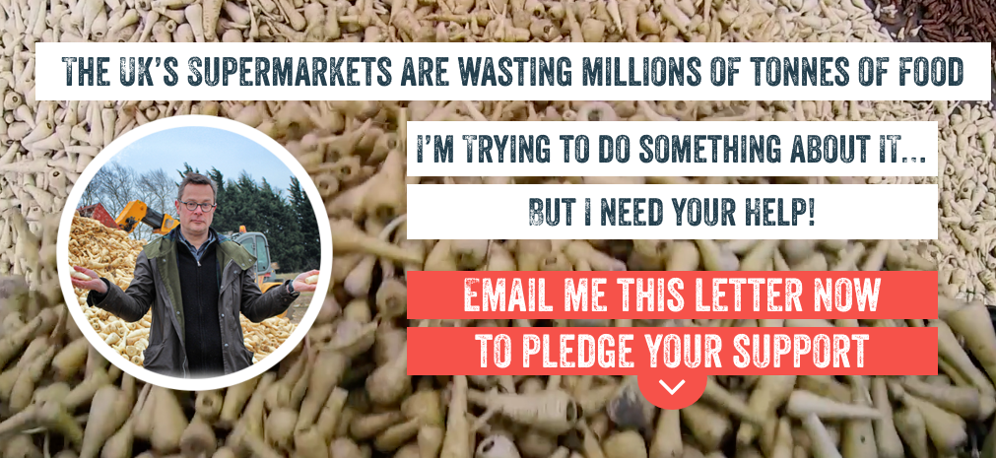
Activity
Convince your local supermarket!
Write a letter or design a poster to persuade your local supermarket to throw away less food.
Use some of the facts and figures you’ve just learnt to and get your point across and convince them.
Notes:
Pupils and parents can pledge their support to stop supermarkets wasting food by visiting https://wastenotuk.com/

Slide 23
Don’t Dump…Decrease!
At the end of the day, ask students to dump the remainder of their lunch into the appropriate bins (food and packaging).
Fill out a chart of what was thrown away and why.
Add waste to the bins for one week and weigh each bin at the end of the week.
Repeat steps 1-3 for a second week and note any difference in weight.
How can you reduce your food waste?
Notes:
Weigh the waste packaging and food for a week and use this to discuss what kind of things the pupils are throwing away. Try to get suggestions on how they could reduce this and maybe send a note home to parents asking them to consider some options. Carry out the same steps for a second week and see if there’s a difference – hopefully there will be less!

Slide 24

School Actions
Help your Eco-Committee research waste at school.
How many food recycling bins does the school have?
Are they being used in the best way?
Are food items in your waste bin that should be in the recycling bin?
What could you do to improve things?
Keep a record of your actions – have they worked?
Notes:
Use the Worksheets Audit 1 and Audit 2 to investigate and report on actions in school.

Slide 25

Submit your findings, actions and results on waste to Eco-Schools by 25th April to be entered into the Wheelie Big Competition.
Shortlisted schools will be invited to present their waste projects in an interesting display at Belfast City Hall on 17th May for final judging.
Win your school a great prize and help work towards your next Eco-School award.
Notes:
Use the Worksheets Audit 1 and Audit 2 along with a short explanation of actions and results at the school and home as your Wheelie Big Competition Entry. Return them by Friday 13th May to be shortlisted. Shortlisted schools will be invited to Belfast City Hall to present a display on their Wheelie Big Waste actions to judges in June. This is a great chance to see what other schools are doing and win a prize for your Eco-Schools work – up to £500.

Slide 26
Useful Contact Information:
Belfast City Council: For educational visits wasteeducation@belfastcity.gov.uk
BCC Cleansing for brown food bins gibsonmichael@belfastcity.gov.uk 07802322892
BELB Waste Contact:
Geoff Alcorn 028 9056 4178
Email: GEOFF.ALCORN@BELB.CO.UK
Eco-Schools :028 9073 6920 eco-schools@keepnorthernirelandbeautiful.org

