Slide 1
Notes:
Welcome to the Wheelie Big Challenge from Eco-Schools, supported by Antrim and Newtownabbey Borough Council

Slide 2
Wheelie’s Lesson
learn and think
Wheelie Big Actions
research and act
Wheelie Big Competition
report, display and win!
Notes:
The Challenge is in 3 parts.

Slide 3
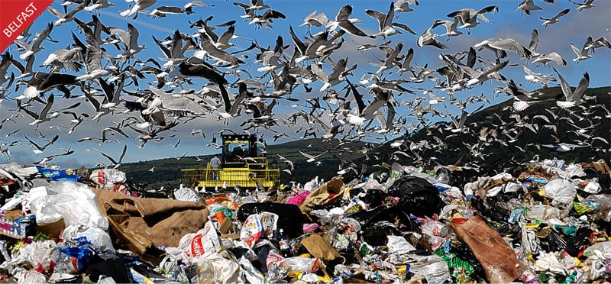
What is Waste?
Waste is rubbish that goes to landfill (the dump)
Notes:
What is waste? – for this challenge we are talking about our rubbish that goes to landfill and is not recycled.

Slide 4
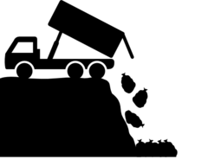
People in Antrim and Newtownabbey send 30,000 tonnes to landfill each year. That’s the same weight as a cruise ship!
The council area recycles and composts about 55% of its waste but it could be as high as 70%! So we can do much better!!
Notes:
We recycle and compost around 55% of our waste in Antrim and Newtownabbey – but we could recycle around 70% - so although this is a good improvement it could be better.

Slide 5
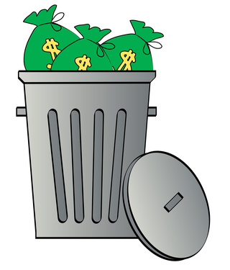
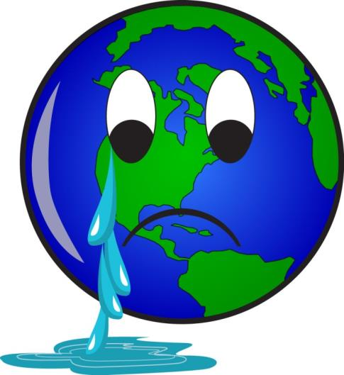
That’s a lot of waste!!
Why should we care?
Because it costs money
and it’s bad for the environment.
Notes:
Disposing of waste costs the tax payer and your council a lot of money. That money could be spent on better things like parks and leisure facilities. Landfill sites are also very bad for the environment, as well as being unsightly, they cause litter and air pollution, harm wildlife and contribute to global warming.

Slide 6
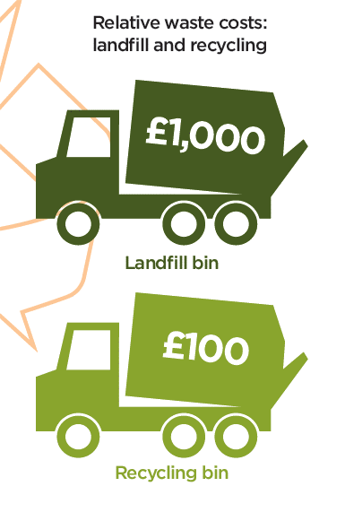
Black bin landfill waste costs nearly 10 times more than recycling.
Black Bin Waste > Landfill costs £1000 / lorry to dispose of.
Recycling Box/Bin > Recycling costs £100 / lorry to recycle.
Notes:
Landfill taxes are increasing all the time which means that disposing of waste this way is expensive. Landfill taxes will cause the cost of a lorry of waste to landfill to increase to £1000 in April 2015. Recycling is a much better option for the environment an our purse strings as it provides a valuable resource for manufacturers and is cheaper than producing new products from raw materials.

Slide 7
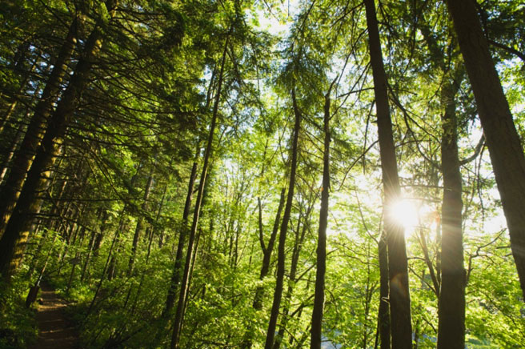
What is paper made from?
TREES
Notes:
Paper is made from trees. The UK needs a forest roughly the size of Wales to meet its paper usage each year.

Slide 8
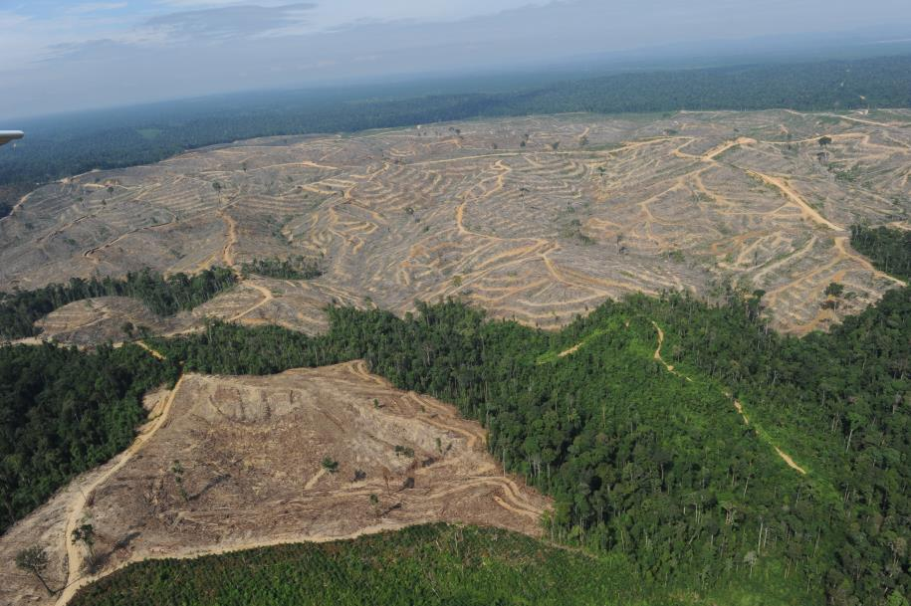
Cutting down trees causes deforestation.
Deforestation has various adverse affects on the environment such as…
Notes:
Can the pupils name any effects of deforestation? Hints – looks ugly, robs the soil of nutrients, destroys habitat, causes floods and landslides, we need trees for oxygen.

Slide 9
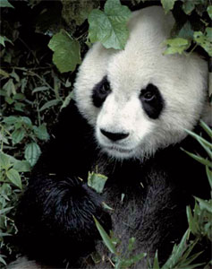
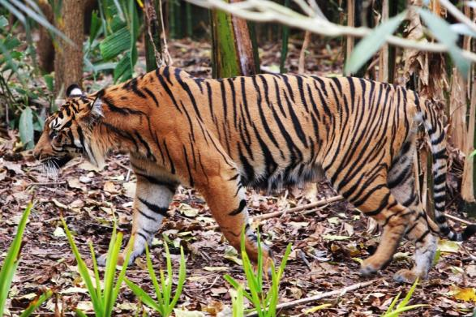
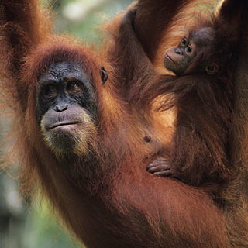
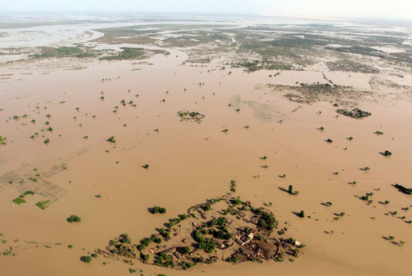
Habitat loss - Some animals around the world are
becoming endangered due to their natural environment being destroyed.
Soil erosion – Causes floods
and landslides,
endangering human
and animal life.
Notes:
The picture of the flooding is from Pakistan 2010 – the impact of these floods were made worse because of deforestation and erosion. More than 1700 people were killed and around 2 million homes destroyed.

Slide 10
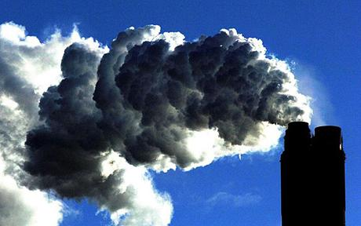
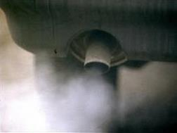
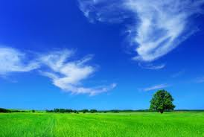
Trees take carbon dioxide from the air and turn it into oxygen.
Trees mean we all can breathe!!
Notes:
We breath out CO2 and produce a lot of it by burning fossil fuels. Trees are important to convert CO2 to Oxygen – they are like the lungs of the planet.

Slide 11
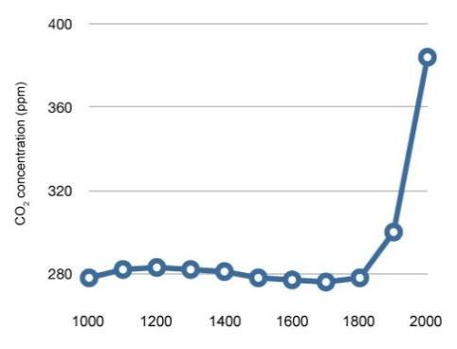
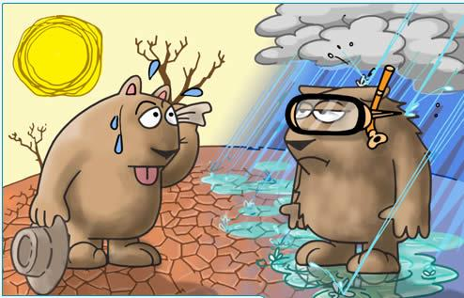
Trees turn our carbon dioxide waste into oxygen so we can breathe.
Carbon dioxide gas affects climate change. It is produced by burning fossil fuels such as coal, oil and petrol.
We produce dramatically more CO2 now that we live in an increasingly industrialized society.
Notes:
The graph shows carbon emissions rising in parts per million (PPM) in the atmosphere. This rises strongly after the year 1800 when industrialisation began. Climate change does not necessarily mean warmer weather. Some countries where it is already warm will experience more droughts and here in Northern Ireland we are likely to experience colder, wetter weather.

Slide 12
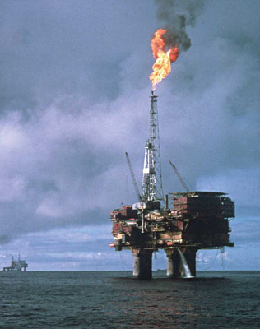
Where does plastic come from?
Plastic is made from oil
Oil is a non-renewable fossil fuel
Plastic production uses 8% of the world’s oil
Notes:
Outline to the pupils or ask them what they feel are the dangers of using a non-renewable fossil fuel.

Slide 13
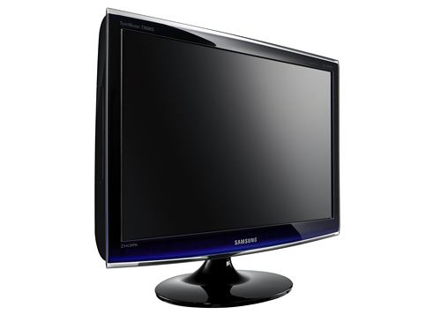
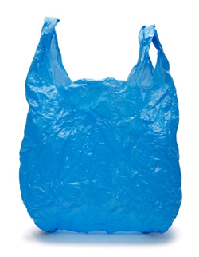
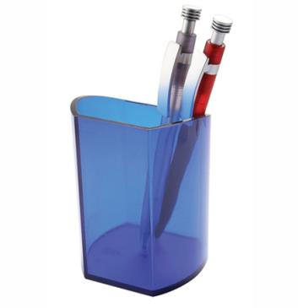
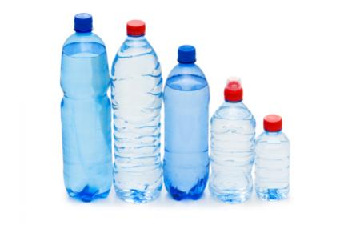
Plastic is a tough, flexible material that does not react with other chemicals. It has revolutionised our world.
Look around the classroom what can you see that is made with plastic?
Our plastic consumption has increased x 20% since the 1950s to around 100 million tonnes of plastic each year world-wide.
Notes:
The pupils will notice that a lot things in the classroom are made from plastic. As well as the obvious there will be things like parts on the blinds, light switches, all electrical equipment including the wiring and flex. They are surrounded by plastic from the moment they are born. What would their grandparents/great-grandparents classrooms have looked like?

Slide 14
How long does it take plastic to break down?
Sunlight UV rays break down plastic the fastest.
Plastic exposed to the sun may take 10-20 years to breakdown.
Plastic in landfill sites with no light will take thousands of years to break down.
Plastic does not biodegrade it just breaks down into smaller and smaller parts.
Notes:
Unlike paper plastic does not biodegrade. Fungus, mould, and little creatures will biodegrade, or ‘eat’, paper as its origins are organic but nothing can feed off plastic. Sunlight is will eventually break down plastic but it is disintegrating into smaller parts not really going away. In landfill where plastic is not exposed to sunlight it will take 100s of thousands of years - forever to breakdown.

Slide 15
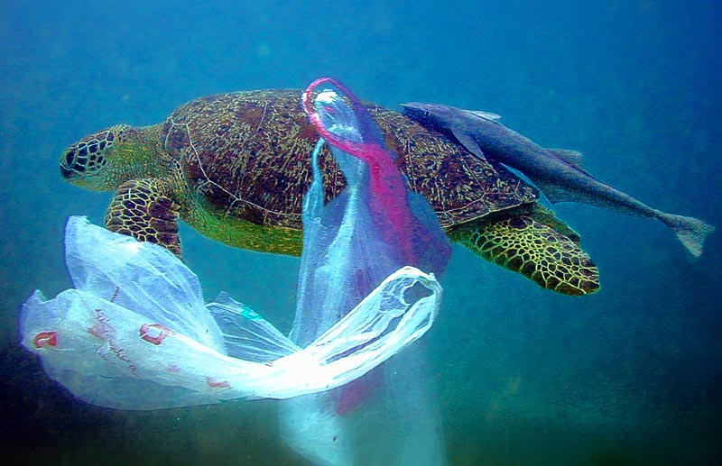
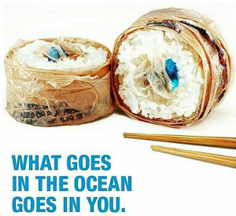
10 million tonnes of plastic ends up in the ocean every year.
90% of floating rubbish in the ocean is plastic.
Every square mile of the ocean contains 46,000 pieces of plastic.
More than a million birds and marine animals die each year from being caught in or eating plastic.
Plastic is entering our own food system with unknown effects to our health.
Notes:
A lot of plastic ends up in the sea (because it floats so well) where it breaks down into tiny pieces and forms vast areas of plastic ‘soup’ in Ocean Gyres (where the current circulates around and creates large still areas). Unfortunately sea animals feed on these pieces of plastic and it causes huge damage/death.

Slide 16
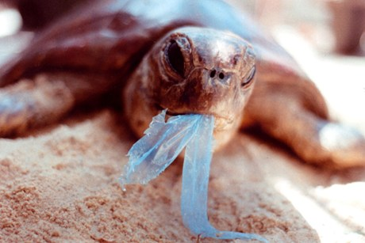
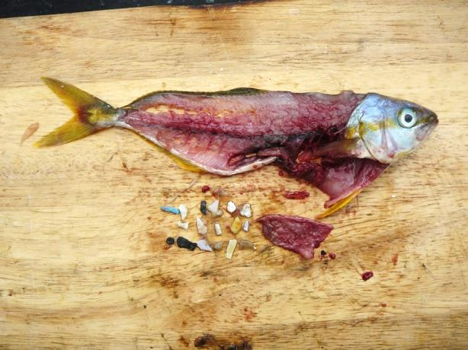
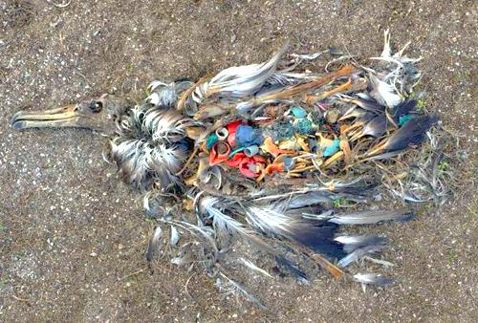
A survey of dead fulmars on
the north coast of Ireland
found them to have an
average of 40 pieces of plastic
in their digestive system
Notes:
Plastic is finding its way into the food system in microscopic particles, the long term effects of this are yet to be discovered. The problem is global and right on our doorstep. As plastic finds its way into our food-stream there are concerns over how it will affect our own health.

Slide 17
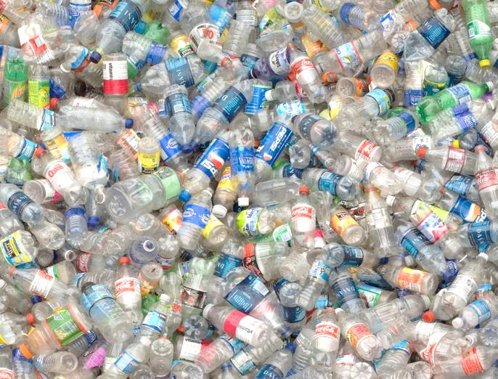
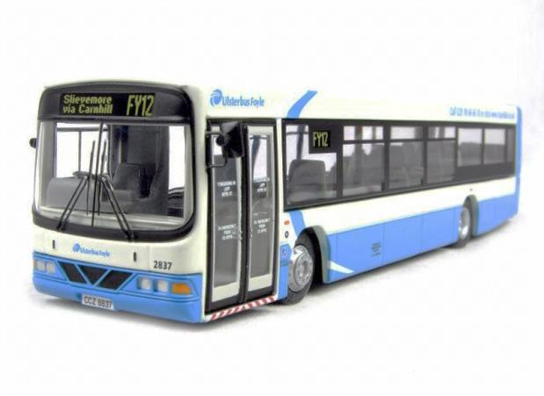
Over 250 million plastic bottles are thrown out each year in Northern Ireland.
When squashed still enough to fill 200 Ulster buses.
200
Every person uses on average 95 plastic bottles each year.
Notes:
We use a huge amount of plastic bottles every year – have the pupils think of everything they buy plastic in – shampoo, drinks, milk, household cleaners, toiletries, medicine etc. Are we too blasé about how many bottles we use?

Slide 18
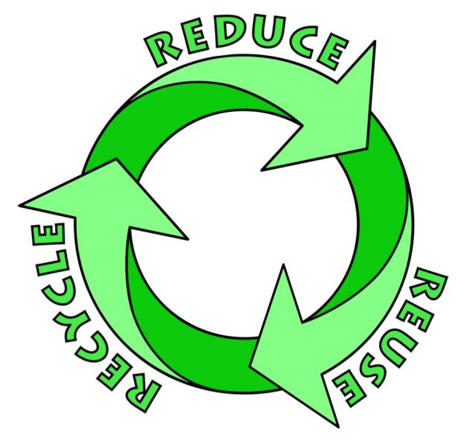
What can we do?
Which is best?
Notes:
The 3 R’s are important if we are to become a sustainable society – but which is best?

Slide 19
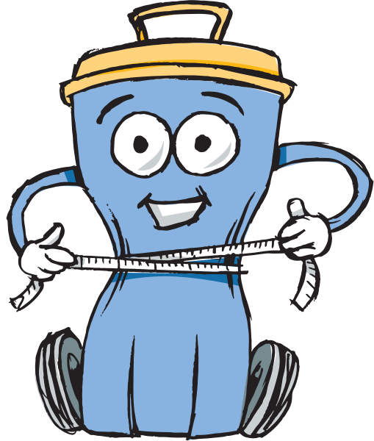
is the best option
Use less paper
write/print on both sides
Use less plastic
less packaging
reuse bottles
Save the environment
Save money
Notes:
Reduce is always the best option because it will use less natural resources and less energy in the first place. Also there is a limit to recycling. Paper can only be recycled around 7 times before the fibres lose their structure so fresh wood pulp will always be needed in paper production. The world would run out of paper in around 3 months if we did not introduce fresh wood pulp into the process. Plastic bottles are not recycled into more bottles. Plastic loses some structural integrity in the recycling process and is commonly ‘down-cycled’ into other products like car dashboards, household items, plastic lumber, clothing etc.

Slide 20
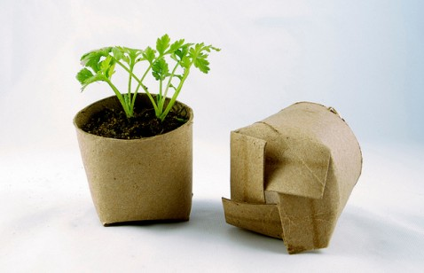
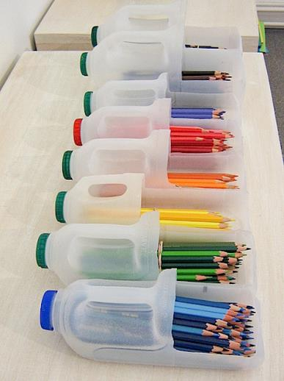
Put scrap paper trays in classrooms
Simply refilling a drinks bottle more than once will help the environment!
Notes:
Reusing is important too – can the pupils think of ways they could reuse materials at home and at school. Encourage them to think of materials as a valuable resource and not just to be thrown away.

Slide 21
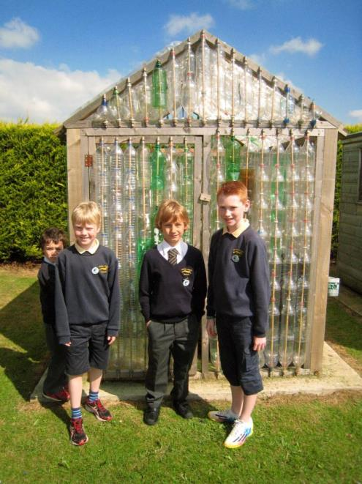
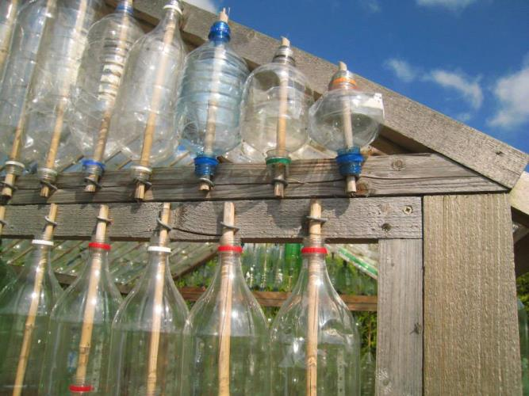
Lots of schools are making their own greenhouses from plastic bottles.
This one is at Limavady Primary School.
Plastic bottle greenhouses are a great idea. You would need around 200 x 2 litre drinks bottles and a wooden frame to attach them to.
www.ecofriendlykids.co.uk/build-greenhouse-plastic-bottles
Notes:
This is a great project to get the whole school community involved in and really raises awareness of reusing plastic in a practical way which results in a really useful addition to your school grounds and eco-work. Check out http://www.ecofriendlykids.co.uk/build-greenhouse-plastic-bottles.html for more hints and tips.

Slide 22
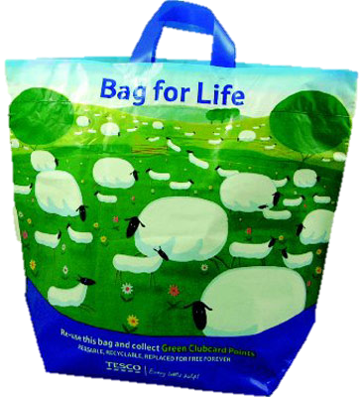
Use a reusable shopping bag
Remember to use your bag!!
Notes:
The first phase of the bag levy in 2013 was very successful and caused a massive reduction in single use carrier bags being used, as well as raising money for environmental projects through the Challenge Funds. The second phase introduced a small 5p levy on cheap reusable bags (those costing less than 20p) to encourage shoppers to actually reuse their bags and not buy new ones each time they go to the shop.

Slide 23
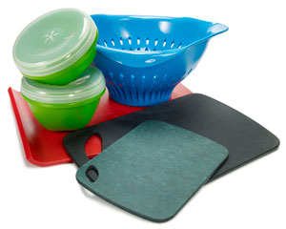
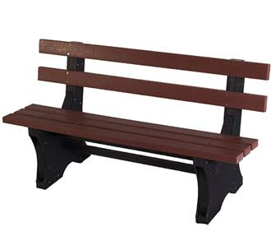
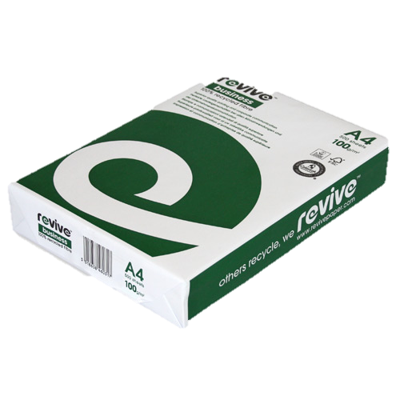
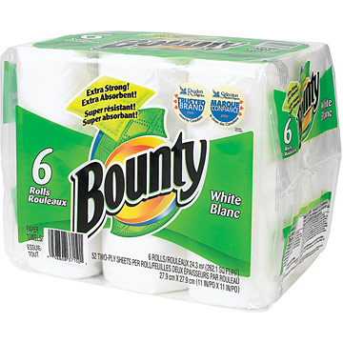
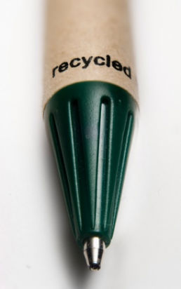
New products
can be
made from
recycled paper
and plastic
Notes:
Can the pupils think of any other products they have commonly seen made from recycled materials.

Slide 24
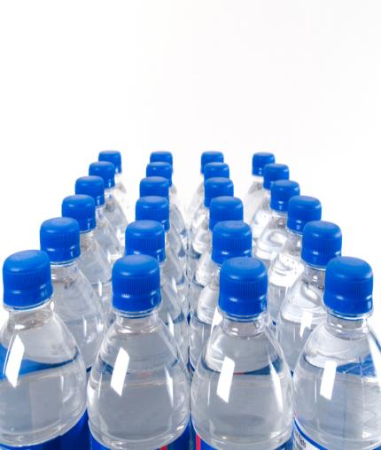
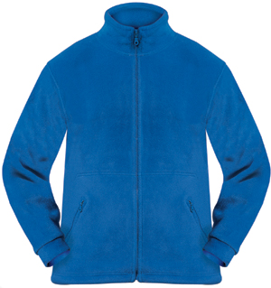
Did you know?
25 recycled plastic bottles can make one fleece jacket.
Notes:
Plastic fibres can be spun into fabric and used to make fleeces and sports wear. Lots of big sports clubs now advertise the fact that their kit is made from recycled materials (for example Manchester United). Puma have launched a recycled and biodegradable range of sports clothing.

Slide 25
Recycling paper rather than using fresh wood pulp-
Uses 70% less energy
Causes 74% less air pollution
35% less water pollution
Saves 7000 gallons of water
(per tonne)
Saves enough energy to heat
the average house for 6 months (per tonne)
Notes:
Recycling does have benefits and definitely should be encouraged.

Slide 26
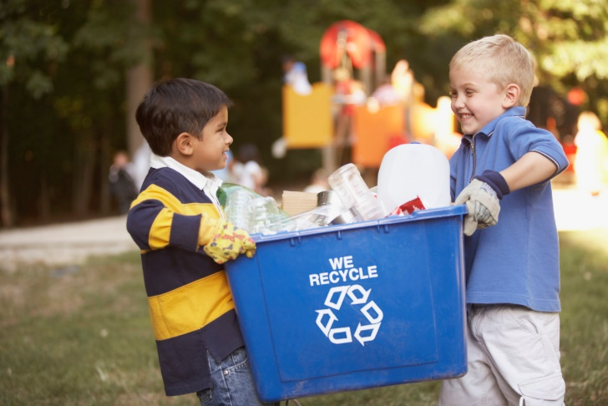
Do you know where your recycling bin is at school?
What colour is your
recycling bin at home?
http://www.antrimandnewtownabbey.gov.uk/Residents/Waste-Recycling/Blue-Bins
Notes:
Ask the pupils what sort of bins they have at home. It’s possible that there is a selection of different things happening at home depending on location and collection routes. Information can be found on your local council website about collections and what can go into which bin.

Slide 27
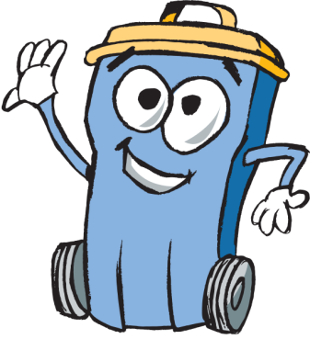
Each school is a bit different with what they can recycle but in general the following items can be recycled: (including at home!)
Notes:
This information is from the Antrim and Newtownabbey Borough Council website where there is lots of helpful advice on recycling at home.

Slide 28
3 Trees Activity
Every family uses around 3 trees worth of paper each year.
Cut 3 tree shapes out of scrap paper.
Stick them all on the board or wall.
How many trees will your families in this class use this year?
Why is this bad?
What can we do to help?
Notes:
Discuss with the pupils all the things they use paper for everyday at school and at home. From scrap paper or old newspapers have each pupil cut out three tree shapes to represent the amount of paper their family uses each year. They could try making a paper chain of trees by folding the paper before they cut it out. If you have time the pupils can decorate/colour in their trees before displaying them. Attach all the trees to a display board or wall space. Have the pupils work out how many trees as a class they and their families use each year, then work out a rough figure for the whole school and their families. Pupils can discuss their feelings on this and what they could do to help the situation. Reflect on what you have learnt in the power-point.

Slide 29
Home Actions
1. Have a sneak peek into the waste bin at home. Is there stuff in there that could be recycled?
2. Visit the Antrim and Newtownabbey Borough Council website http://www.belfastcity.gov.uk/bins-recycling/bins-recycling.aspx and check what goes in your bins.
Notes:
It is important that pupils recycle not only in school but at home as well. Here are 4 ideas that you could set as a homework task for pupils and they can follow up and discuss the results in class. Include home actions taken in your reporting for the Wheelie Big Competition – we love to hear your ideas and the results.

Slide 30
School Actions
Help your Eco-Committee research waste at school.
How many recycling bins does the school have?
Are they being used in the best way?
Are items in your waste bin that should be in the recycling bin?
What could you do to improve things?
Keep a record of your actions – have they worked?
Notes:
Use the Worksheets Audit 1 and Audit 2 to investigate and report on actions in school.

Slide 31
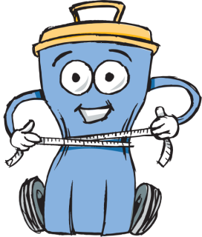
Submit your findings, actions and results on waste to Eco-Schools by Thurs 16th May to be entered into the Wheelie Big Competition.
Shortlisted schools will be invited to present their waste projects in an interesting display at Mossley Mill on 30th May for final judging.
Win your school a great prize, up to £500, and help work towards your next Eco-School award.
Notes:
Use the Worksheets Audit 1 and Audit 2 along with a short explanation of actions and results at the school and home as your Wheelie Big Competition Entry. Return them by 2nd May to be shortlisted. Shortlisted schools will be invited to Mossley Mill to present a display on their Wheelie Big Waste actions to judges 30th May. This is a great chance to see what other schools are doing and win a prize for your Eco-Schools work!

Slide 32
Useful Contact Information: Antrim and Newtownabbey Borough Council, Waste Education and Awareness Officer: 028 9034 0254 Joanne.Templeton@antrimandnewtownabbey.gov.uk for visits and composting advice.
Eco-Schools :028 9073 6920 eco-schools@keepnorthernirelandbeautiful.org

